Slide 1
Multiclass classification
Thang Nguyen

Slide 2
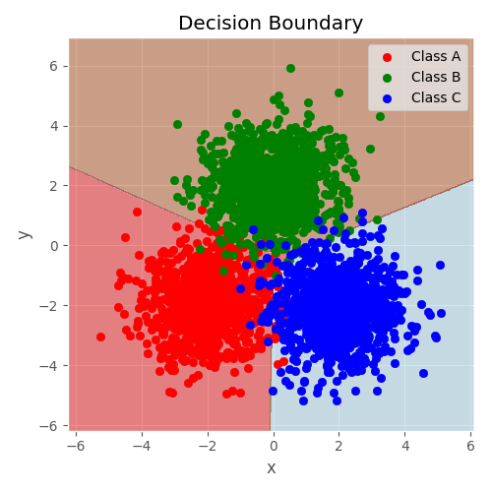
Multiclass classification
More than 2 classes

Slide 3
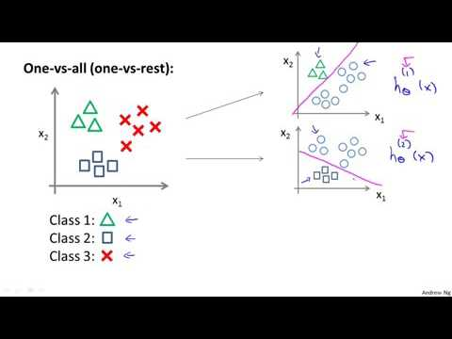
One vs all
Main class is Positive class, other classes
are negative class

Slide 4
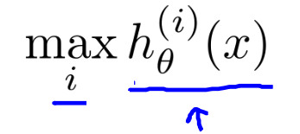
One vs all
On a new input , to make a predicton, pick the class that maximizes

